Slide 1

PRESTASHOP DEMO
CAPSTONE PROJECT
BY
TOLETI PAVAN
G RAM CHARAN
LOKESH NAMALA
AKSHAY KUMAAR NATVA S
MYAKA SAI VIKRAM REDDY
DAMARUDH VARMA DANDU
BUTUKURU OJASWIN REDDY
Link
https://demo.prestashop.com/#/en/front
TRAINER
B. ANAND

Slide 2
Project Overview
The primary objective of this project is to automate the testing of the PrestaShop Demo e-commerce website using Selenium WebDriver.
Automate major user workflows of the PrestaShop website.
Validate the functionality of web elements and user interactions.
Implement a maintainable automation framework using the Page Object Model (POM).
Follow the Behaviour-Driven Development (BDD) approach using Cucumber.
Generate detailed execution reports using Allure and HTML Reports.

Slide 3
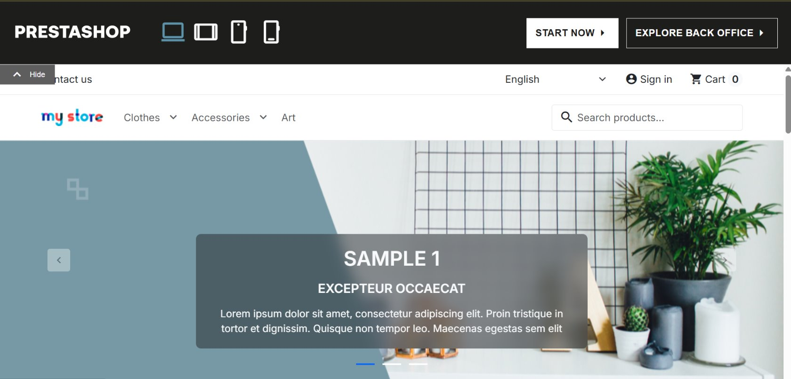
Functionalities Covered
User Management:
Signup
Login
Logout
Product Management:
Search Product
Filter Product
Multiple Product Adding
Shopping Features:
Shopping Cart
Orders
Checkout:
Guest Checkout
Registered Checkout

Slide 4
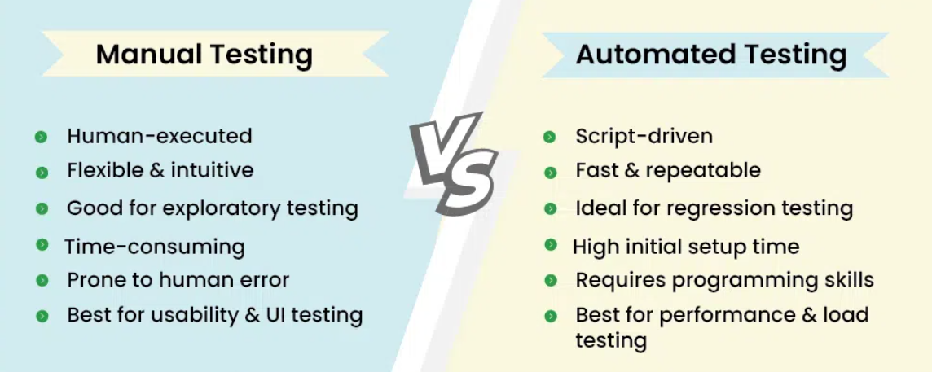
How to Test??

Slide 5
Test Scenarios & Test Cases
Signup Sign In Selecting Product
Logout Proceed to Add to cart
Checkout
Home Page
Registration
Sign In page Login
Search Product
Product Details
My Account Logout
Checkout Payment Orders
Add to Cart Shopping Page

Slide 6
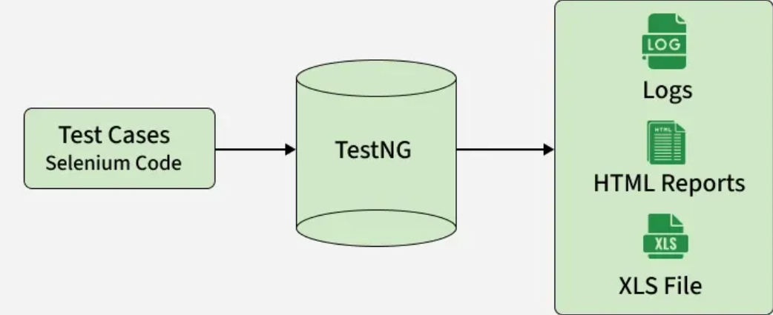










Tech stack used
Programming Language
Browser Automation
BDD Testing
Test Execution
IDE
Dependency Management
Test Automation Design Pattern
Report Generation
Version Control
Project Management Tool

Slide 7
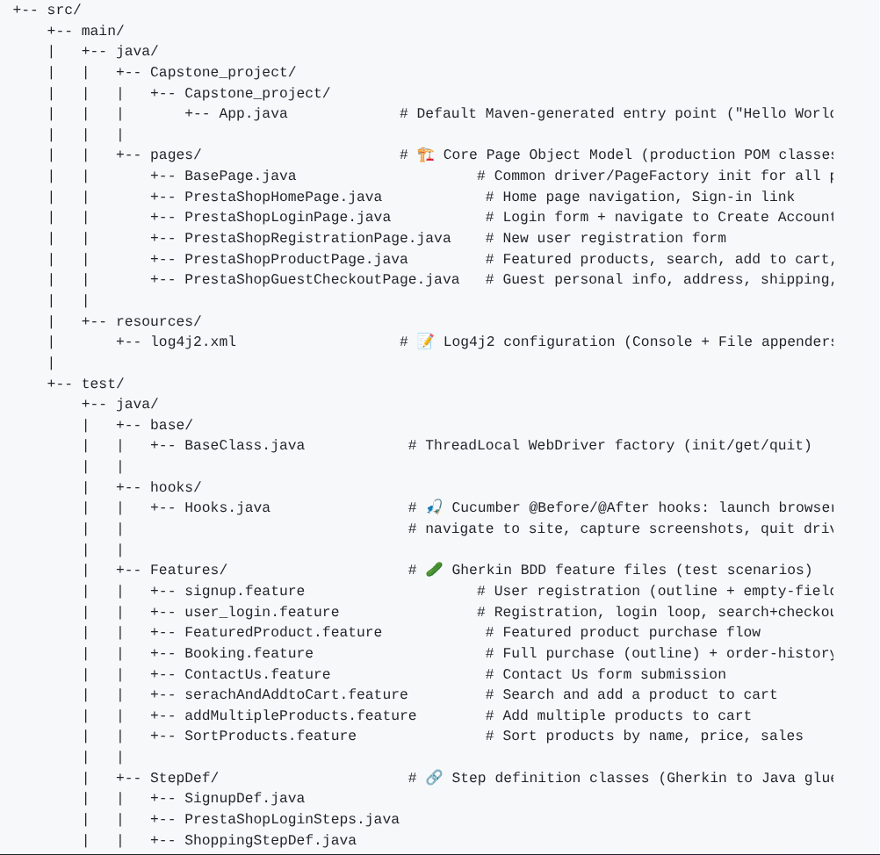
Project Structure
src/main/java
Pages
Src/test/java
Base Class
Hooks
Features
StepDef
Runner
Utilities

Slide 8
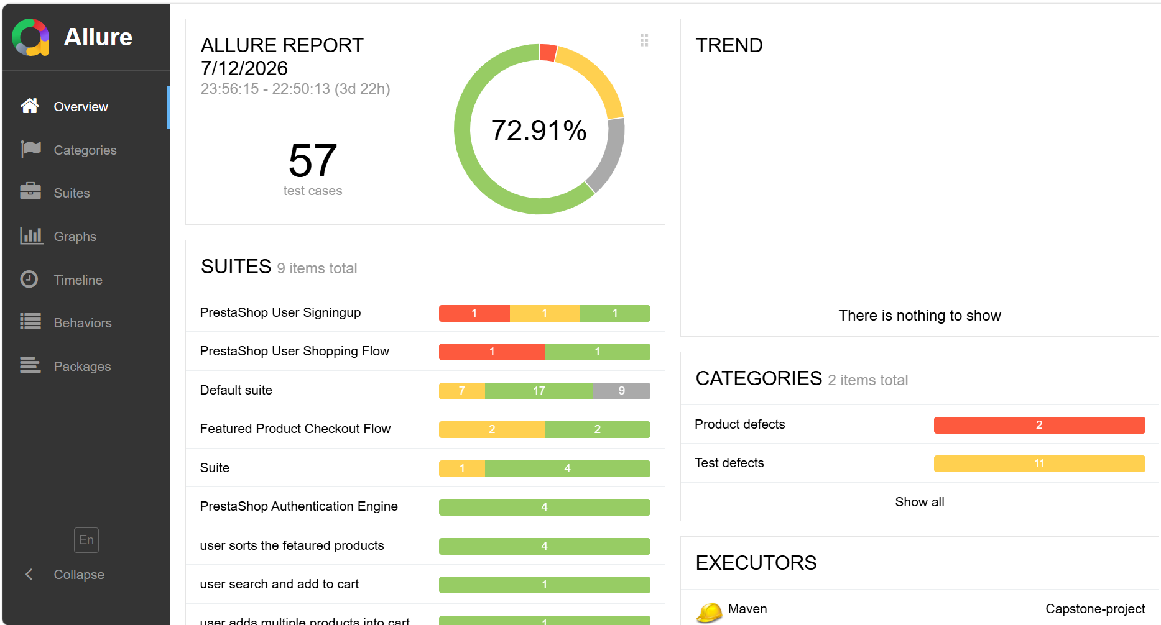
Reports
Allure Reports:
Execution summary
Pass/Fail/Break Statistics
Timeline view
Detailed logs

Slide 9
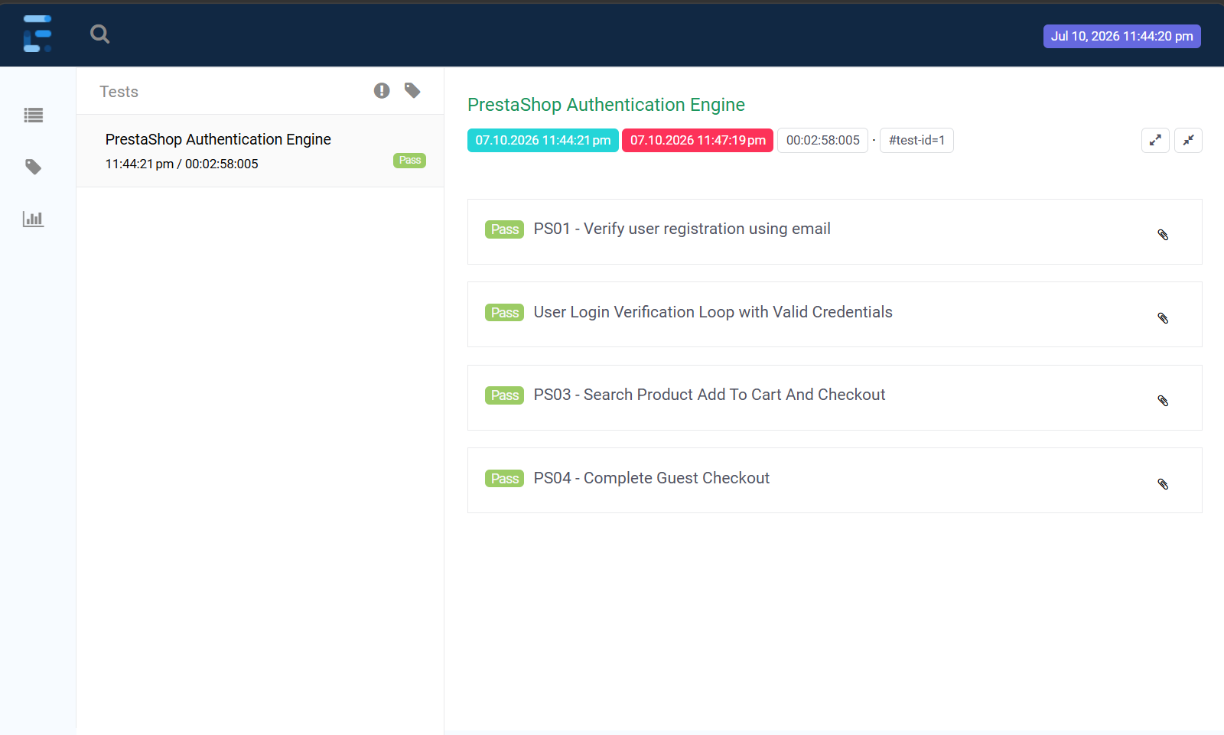
Extent Reports
Test Summary
Pass/Fail Status
Execution Results
Trend Analysis
HTML reporting
Easy Debugging

Slide 10
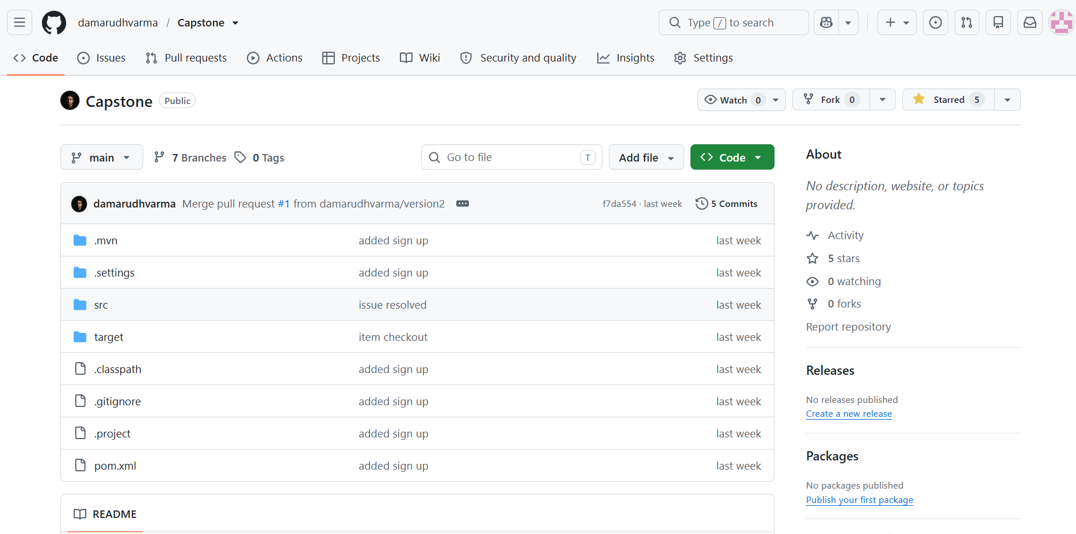
Github Integration
Initialize Git repository
Connect local project to GitHub
Create and use branches for new features
Commit changes with meaningful messages Push code to the remote repository
Pull latest updates before starting new work

Slide 11
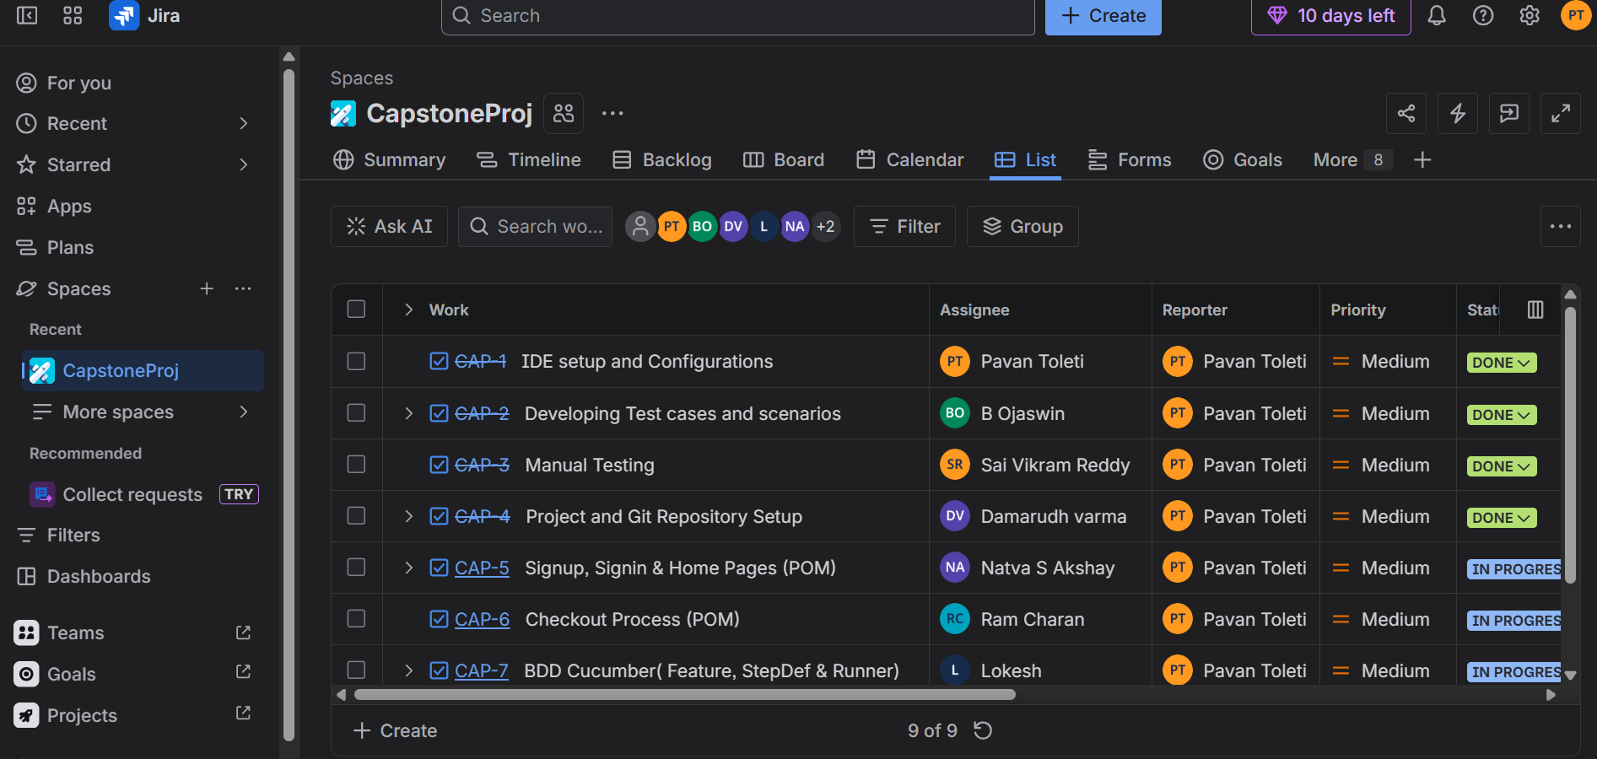
Jira Integration
Created and managed test tasks.
Reported and tracked defects.
Assigned priorities and issue status.
Monitored bug resolution progress.

Slide 12
Conclusion
Successfully automated major modules of Presta Shop Application.
Using Selenium, Java, Testng, Cucmber, we systematically tested key functionalities such as login, product search, cart management and checkout.
POM and Cucumber’s BDD framework provided efficient test case management and clear scenarios.
Allure and Extent Reports enhance test reporting by providing clear, detailed, and interactive insights, enabling efficient test analysis and faster defect identification.
Overall, the project confirmed that automation significantly improves the testing process, ensuring high standards of web application performance and user experience.

Slide 13


